Slide 1


MQF Capital Management QF603 Quantitative Analysis of Financial Markets
Duy Hung (Mike), Xiwen, Stephen, Mingze, Cedric

Slide 2
Table of contents
01
02
03
Introduction Cedric
Stage 1 : OLS Models Xiwen & Stephen
Stage 1: Arima Models Mike & Ming Ze
04
05
06
Stage 1: Trading Rules & P&L Tabulation Cedric
Stage 1: Results: Sharpe Ratio, CAGR, Historical Volatility
Stage 2: 1-Year Forward Predicted Stock Returns Comparisons
07
Appendix

Slide 3


Project End Goal: Phase One and Two
Phase 1 “Mission”:
Finding out if investing in Netflix via an equal weight portfolio consisting of quantitative models and fundamental model delivers a higher Sharpe ratio versus just investing in Netflix through a standalone fundamental model
Phase 2 “Mission”:
Comparing the one-year forward Netflix stock price predicted by both the quantitative models and fundamental models and accounting for their differences
Problem
1. OLS
2. Arima
3. Arima-X
4. Fundamental
US$25m
Capital
US$25m
Capital
US$25m
Capital
US$25m
Capital
Notes:
Good afternoon everyone, we are a group of equity analyst from a 1US$00m known as MQF capital management and we are here to deliver the results of the two phases of our project

Slide 4

Phase 1: OLS Models Xiwen & Stephen
02

Slide 5



10Y Russell 1000 Annual Data
1） EBITDA Margin
2） Gross Profit Margin
3） E/P ratio (net income/market cap)
4） ROIC (Return on Invested Capital)
5） ROA (Return on Assets)
6） ROE(return on equity）
7） ROCE(Return on capital employed)
8) Enterprise Value / Sales
9） Current ratio
10） Debt to Equity
11） Debt to Asset
12）Cash to debt
13） Volatility 360d
14） Sales Growth
15） WACC
16） Market Capitalization

Slide 6

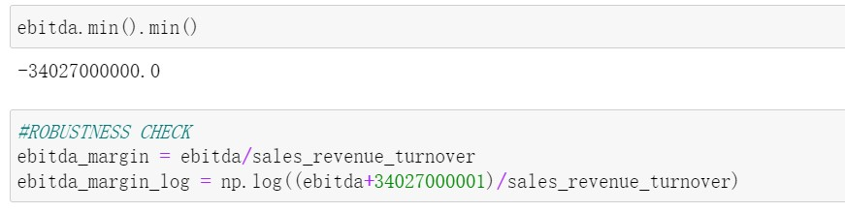

DATA Preprocessing
1. Log Transformation
Enhance the linear relationship between dependent and independent variables
Minimize the impact of outliers by compressing the dataset
2. Constants for small numerator/denominator issues
Check the minimum value for ratio factors
Avoid negative or invalid values before performing log transformation
Apply Robustness
Check

Slide 7
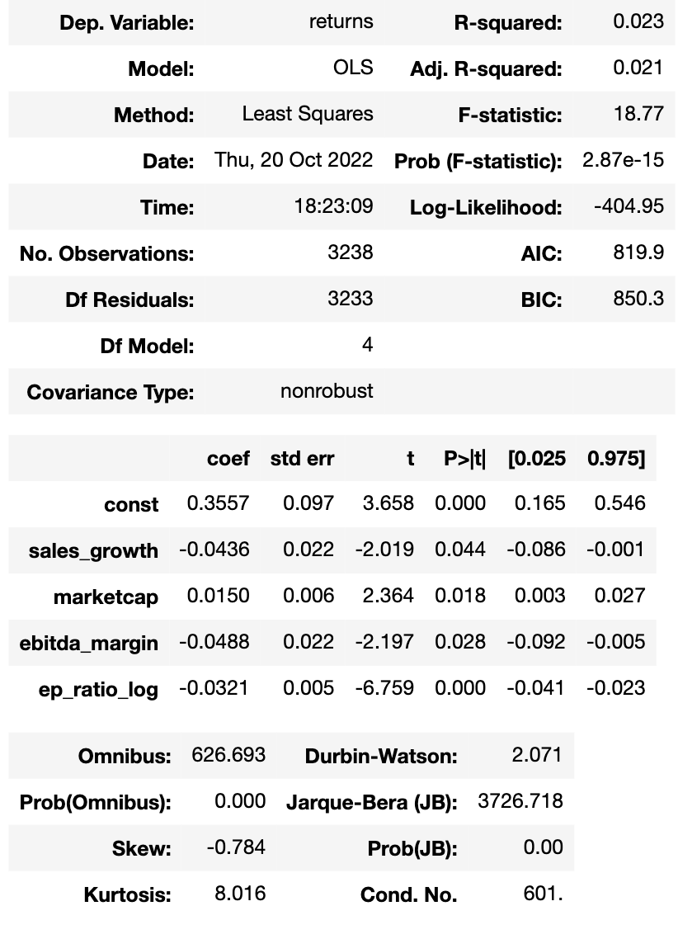
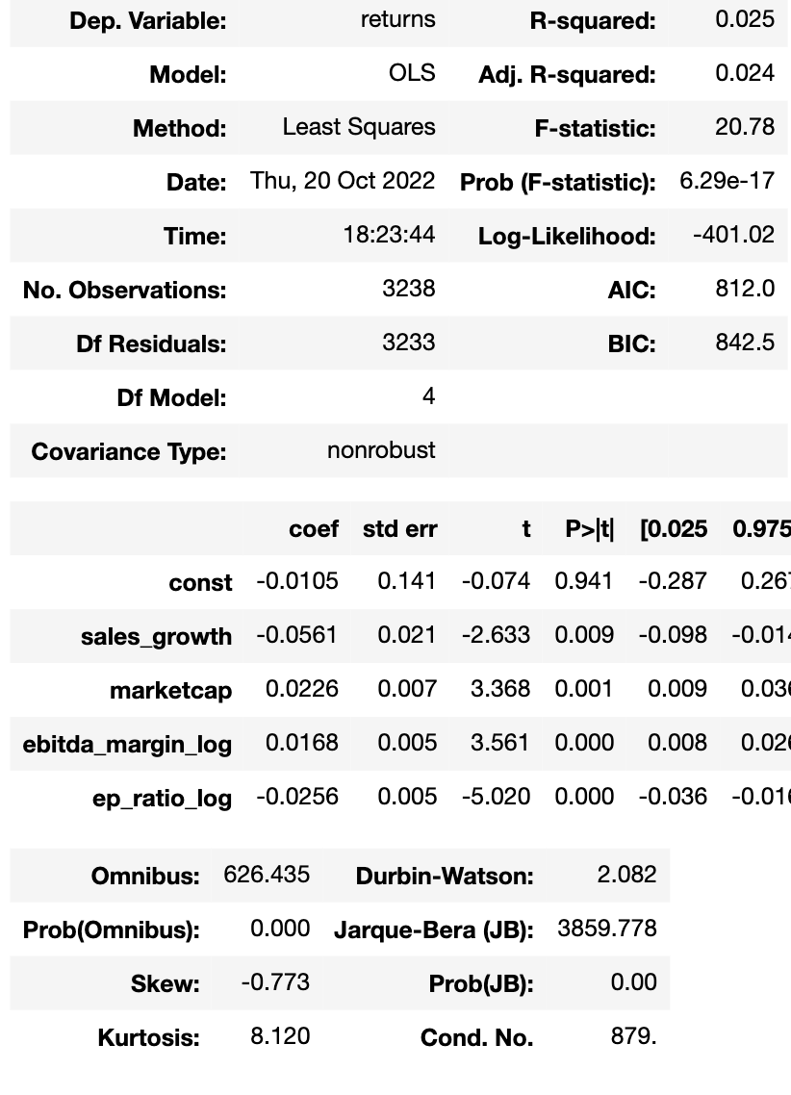


Robustness Check:
Scenario 1: Without logging
Scenario 2: Logging after adding a positive constant

Slide 8
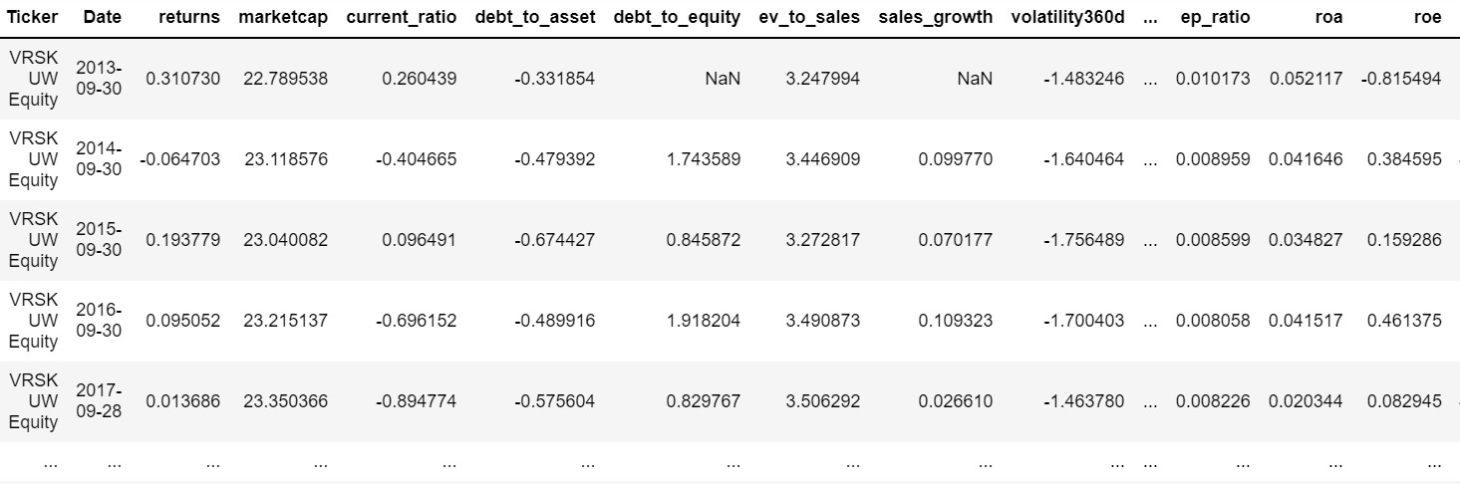
OLS model Data Partitioning
Training Set:
End Sep 2012 – End Sep 2020
( 8 years)
Testing Set:
End Sep 2020-End Sep 2022
( 2 years)
20%
80%

Slide 9
10Y Russell 1000 Annual Data
1） EBITDA Margin
2） Gross Profit Margin
3） E/P ratio (net income/market cap)* (added a positive constant)
4） ROIC (Return on Invested Capital)
5） ROA (Return on Assets)
6） ROE(return on equity）
7） ROCE(Return on capital employed)* (added a positive constant)
8) Enterprise Value / Sales
9） Current ratio
10） Debt to Equity
11） Debt to Asset
12）Cash to debt
13） Volatility 360d
14） Sales Growth
15） WACC
16） Market Capitalization

Slide 10
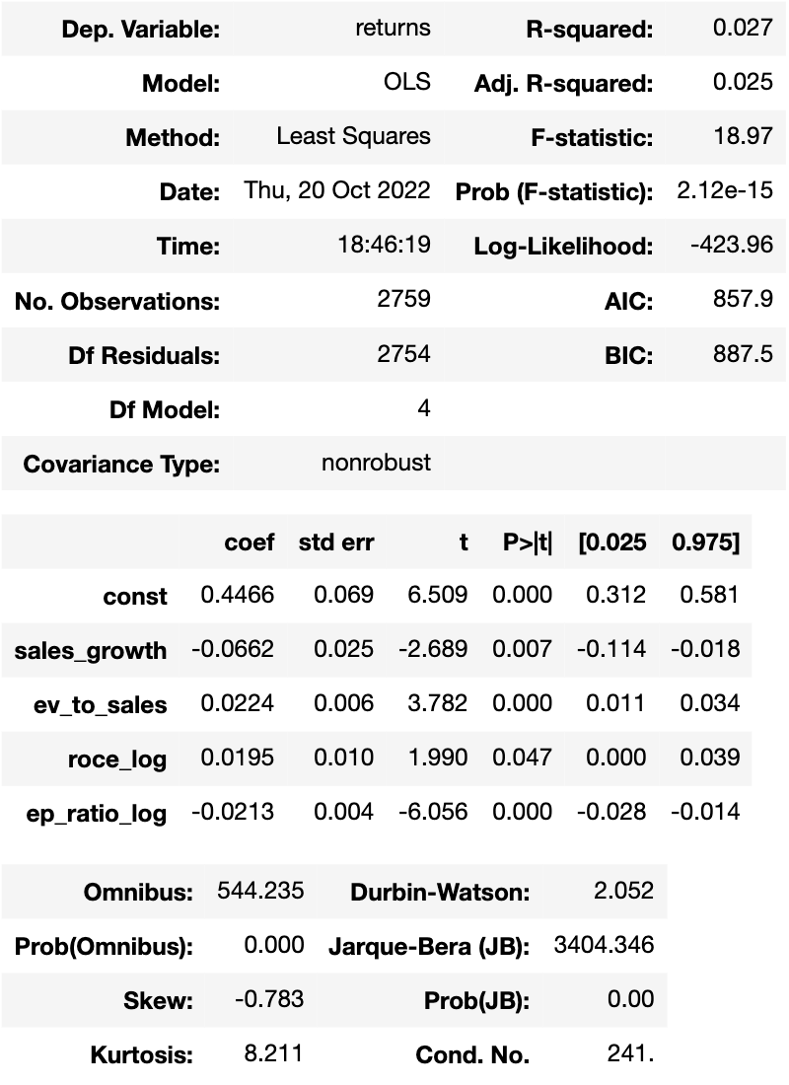
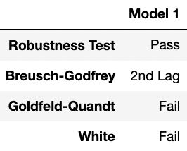
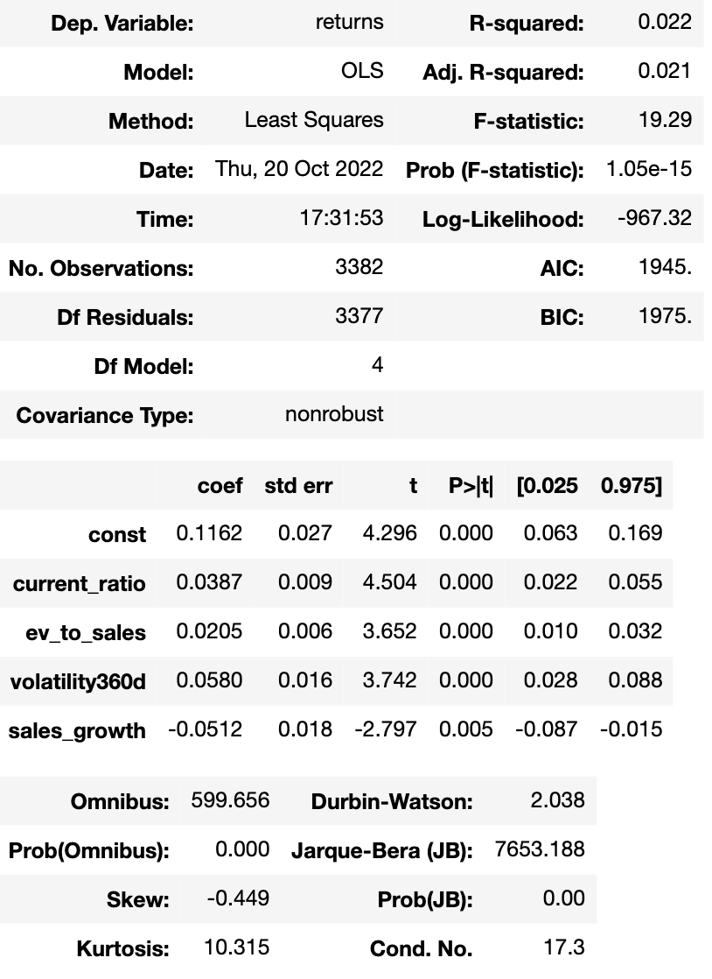
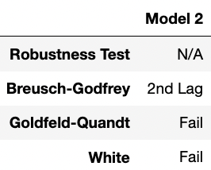
























Model 1
Model 2
Shortlisted Models
Problem
Notes:
Thanks XiWen, here I will talk about the shortlisted models for OLS as well as the decision criteria for model selection.
For Model 1 we picked sales growth, ev to sales, roce and ep ratio
For Model 2 we picked current ratio, ev to sales, HISTORICAL VOL and sales growth
Adjusted R square for model 1 & 2 are 2.5% & 2.1% respectively. These are feasible for OLS models threshold of 2% according to Prof Ben. Prob(F) = 0 implies that our beta estimators are significant and have explanatory powers over Russell stock returns.
P-value of T statistics below 5% means that each factors are significant and provides meaningful contribution to the model’s prediction.
Prob(JB) equal to 0 means the residuals are not normally distributed (A5 assumption does not hold), However this fine if p-value of our factors are insignificant. The models exhibit negative skew and kurtosis > 3 which is in line with empirical asset returns.
Durbin Watson hovers around 2 for all of our shortlisted models which means there is no lag 1 autocorrelation. We also performed Breusch Godfrey test and confirmed no autocorrelations in lag 2. However, it fails on lag 3 onwards.
Next, we also ran Goldfeldt-Quant & White tests to measure heteroscedasticity. Unfortunately, all models failed both tests.
From the tests we conclude that A3 & A4 are violated, and there are still time series information on the residuals. We've considered Arima-X & VECM to mitigate this issue but in the interest of time we passed on VECM model.
The OLS models still gives unbiased coefficient estimates, however the standard errors could be underrepresented/overestimated depending on the form of heteroscedasticity and as a result WE HAVE TO REDUCE OUR LEVEL OF CONFIDENCE IN PREDICTED FITTED VALUES BY OUR OLS MODEL

Slide 11
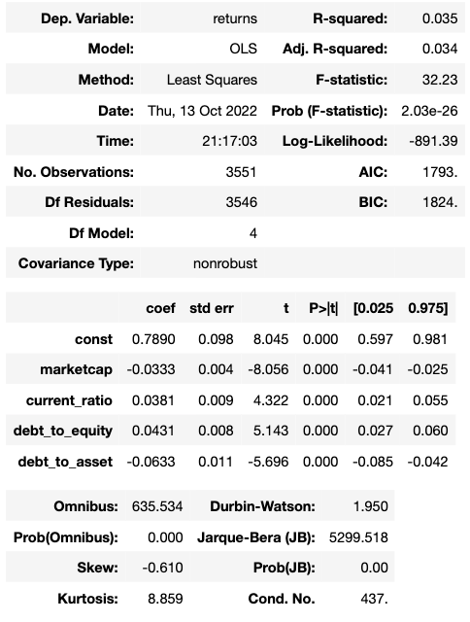
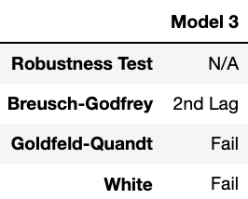
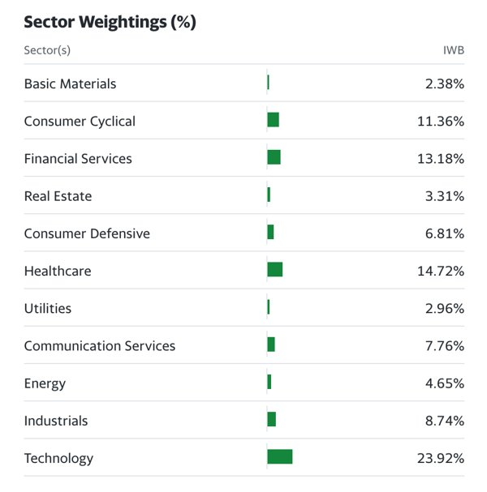










Shortlisted Models (Cont.) (Russell 1000 Sector Codes)
Model 3
Problem
Notes:
And the last shortlisted model is 3. Here we model returns using Marketcap, Current Ratio, D/E and D/A.
Robustness Check is not required in this case, and the p-values of coefficients are zero.
For this model, we wish to take a step further and implement Liang-Zeger standard errors, also known as clustered standard errors.
The table on your right displays the breakdown of Russell 1000 constituents into 11 sectors, along with their sector weightages.
Clustering offers a simple and effective way to account for non-independence in modeling residuals within each sectors (A.K.A "autocorrelation in residuals").

Slide 12
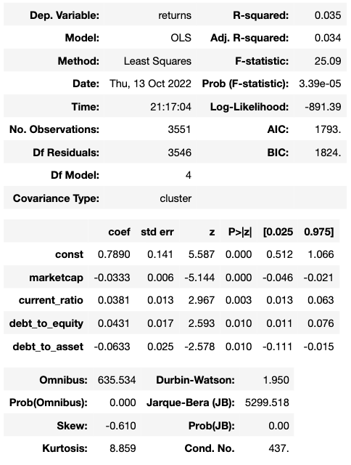








Standard Error Clustering (Russell 1000 Sector Codes)
Model 3 Without Clustering
Model 3 With Clustering
Problem
Notes:
Once Standard Error Clustering is performed, we can observe that the t-statistics saw a general decrease while the standard errors generally went up.
However, this implies that standard errors are robust to cluster covariance, and provides higher confidence to our coefficients as predictors of stock return.

Slide 13

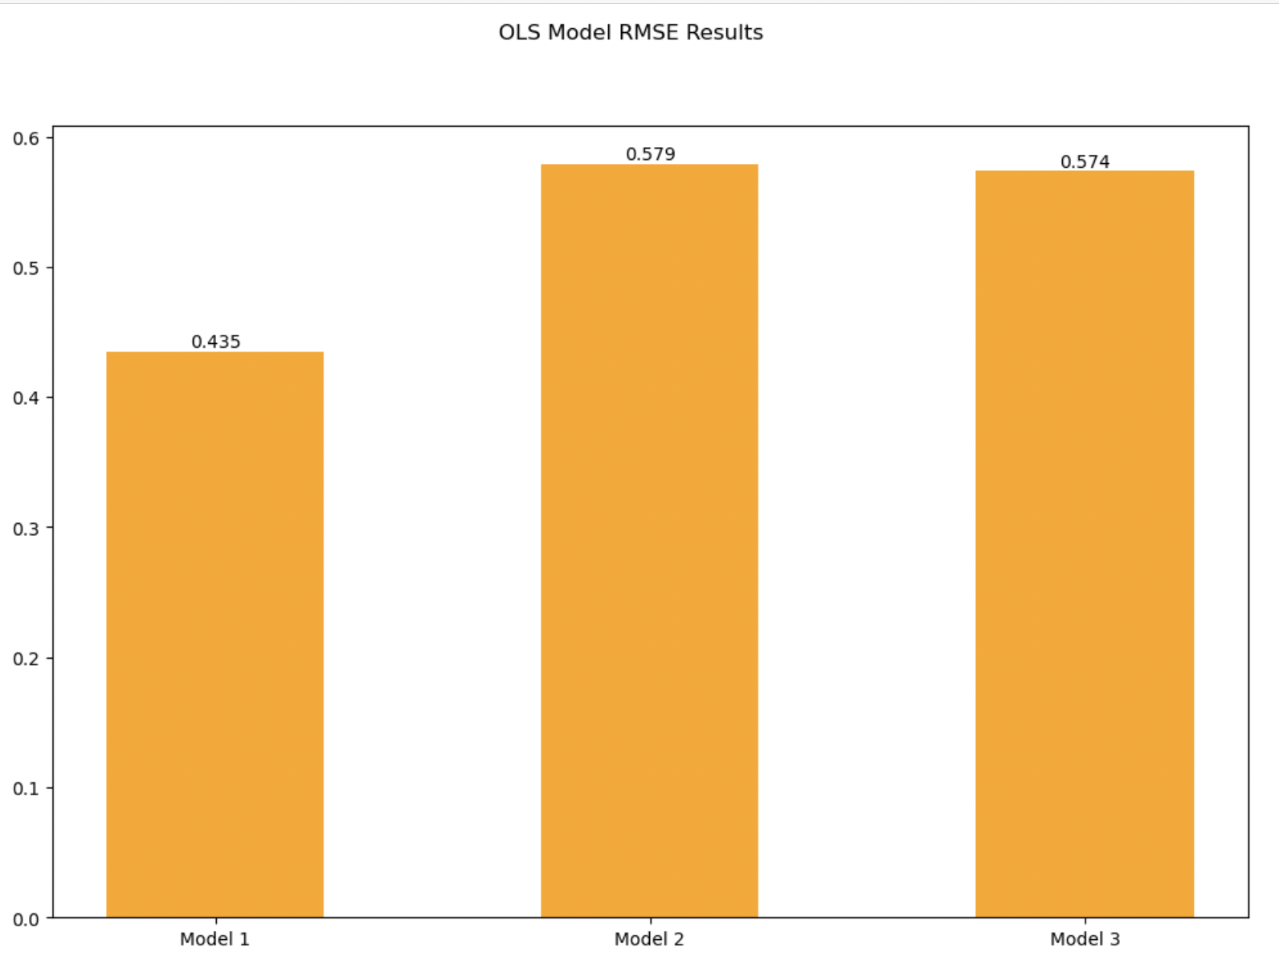
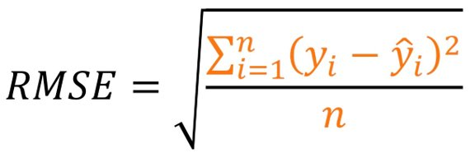
Online
Model Selection – OLS Testing RMSE
Notes:
So which models should we pick then? We will benchmark our models using RMSE & MAPE calculations.
Here is the RMSE values of our Testing Dataset. We observe that Model 1 has the lowest RMSE which implies that it has the smallest gap between Actual vs Predicted returns.

Slide 14
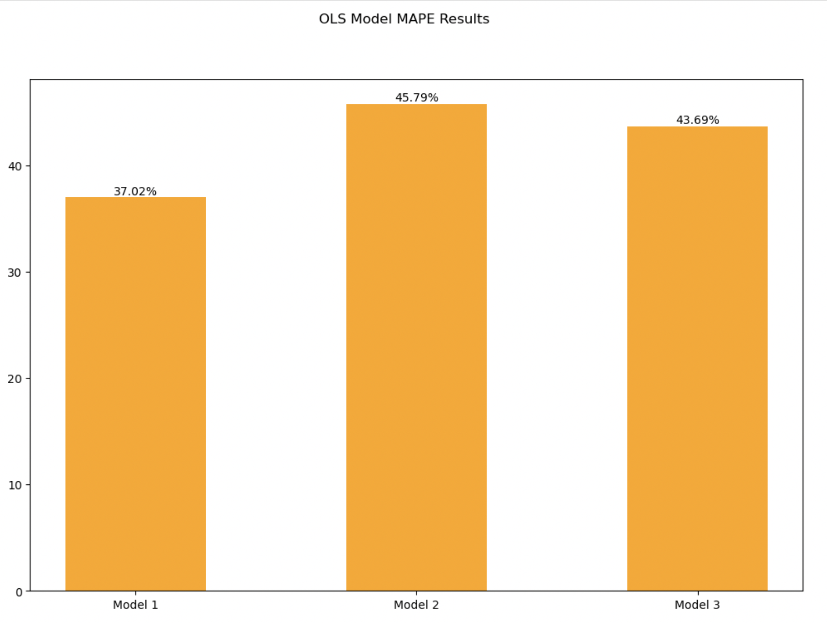
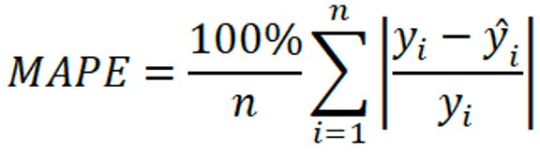
Online
Model Selection – OLS Testing MAPE
Notes:
Here is the MAPE values of our Testing Dataset. Again, we observe that Model 4 has the lowest MAPE and thus it is the chosen model for our OLS phase 2: forecast of NFLX returns which will be delivered to you by Cedric.
This concludes our OLS model presentation. Now, I would like to hand over to Mike and Mingze who will be presenting our Arima & Arima-X Models,

Slide 15

Phase 1: Arima Models Mike & Mingze
03

Slide 16
ARIMA Model Data Partitioning
Training Set:
End of September 2010 to
End of September 2020
(10 Years)
Decompose the Data
Seasonal Components and Seasonal Adjusted Component
ARIMA Model
From:
End of September 2010
To
End of September 2022
Testing Set:
End of October 2020 to
End of September 2022
(2 Years)
Build the Model on Each Component
Then added both components forecast valued to NFLX forecasted price

Slide 17



ARIMA Data Preprocessing
Added a constant to seasonal component
value since box cox cannot take negative value
Observe the ACF and PACF for each component
Data should be covariance stationary and variance within a constant range
Deduct the forecast for seasonal data by the same constant later
Via checks for seasonal differencing, differecing and Box-Cox transformation
Formulate hypotheses on the potential order for possible ARIMA models

Slide 18




Arima Model Formulating
Step 1
Step 2
Step 3
4 ARIMA models are shortlisted based on AICc and Ljung-Box test statistics
Include one Auto ARIMA model
Final models for each component are decided based on which model gives the lowest RMSE and MAPE in the testing set.
Obtain the forecast Netflix price over both training and testing periods, as well as one year into the future

Slide 19
Potential ARIMA Models
Type | Order | AIC | AICc | BIC
Seasonal 1 | (0,0,0)(1,1,0) | -747.89 | -747.78 | -742.51
Seasonal 2 | (0,0,0)(2,1,0) | -749.26 | -749.03 | -741.19
Seasonal 3 | (1,0,0)(1,1,0) | -752.15 | -751.92 | -744.07
Seasonal Auto | (1,0,0)(0,1,0) | -612.98 | -612.75 | -604.9
Seasonal Adj 1 | (0,1,3)(0,0,2) | 130.63 | 131.37 | 147.36
Seasonal Adj 2 | (0,1,3)(2,0,0) | 131.84 | 132.58 | 148.56
Seasonal Adj 3 | (1,1,3)(0,0,2) | 132.57 | 133.57 | 152.08
Seasonal Adj Auto | (0,1,0)(0,0,0) | 134.33 | 134.43 | 139.9
Notes:
Performs a lot better with SAR component

Slide 20
Results for ARIMA Models
Results for ARIMA Models
Seasonal Models | Seasonal Adj Models | RMSE | MAPE
S1 | SA1 | 132.04 | 32.25
S1 | SA2 | 155.48 | 42.51
S1 | SA3 | 132.73 | 32.61
S1 | SA Auto | 282.99 | 77.51
S2 | SA1 | 132.04 | 32.25
S2 | SA2 | 155.48 | 42.51
S2 | SA3 | 132.73 | 32.61
S2 | SA Auto | 282.99 | 77.51
S3 | SA1 | 282.99 | 77.51
Seasonal: (0,0,0)(1,1,0)
Seasadj: (0,1,3)(0,0,2)
Notes:
RMSE and MAPE for each combination over testing set
S1 does not give the lowest AICC, but AICC is not the sole selection criterion. Ultimately we want to see how well the model performs in testing set, hence we use RMSE and MAPE as the criteria that holds the most deciding power
Question:
Since there are two sets of models, how did u obtain one set of RMSE and MAPE? Elaborate on the process

Slide 21
Motivation
TS information in OLS residuals
Other valuable factors impacting NFLX
Procedure
Ensure stationarity of all variables prior to model building
ARIMA-X
Variables
Independent: EV-to-sales / sales growth / EP ratio / ROCE
Dependent: log-returns of NFLX
Model order
ARIMA order on OLS residuals

Slide 22
ARIMA-X Procedure
Perform OLS on chosen variables and extract the residuals for ARIMA fitting
2
Render all variables stationary to the same integration order
Fitting ARIMA-X with ARIMA orders and independent variables
Forecast
Use X_{t-1} for forecasting into the future
1
4
Perform Box-Cox if need
Observe ACF & PACF of OLS residual for hypothesis of ARIMA orders
3

Slide 23
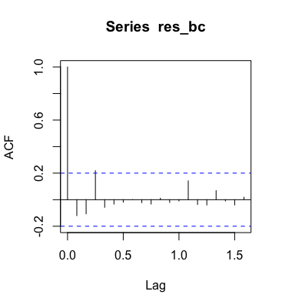
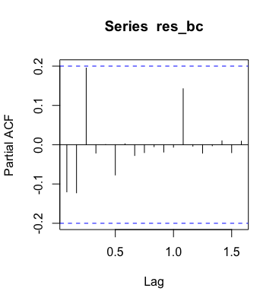
ARIMA-X order - ACF & PACF
- Possible exponential decay in PACF -> MA?
- ACF suggests possibility for MA(3)
Notes:
Highlight that it is indeed possible to have seasonal pattern in seasadj

Slide 24
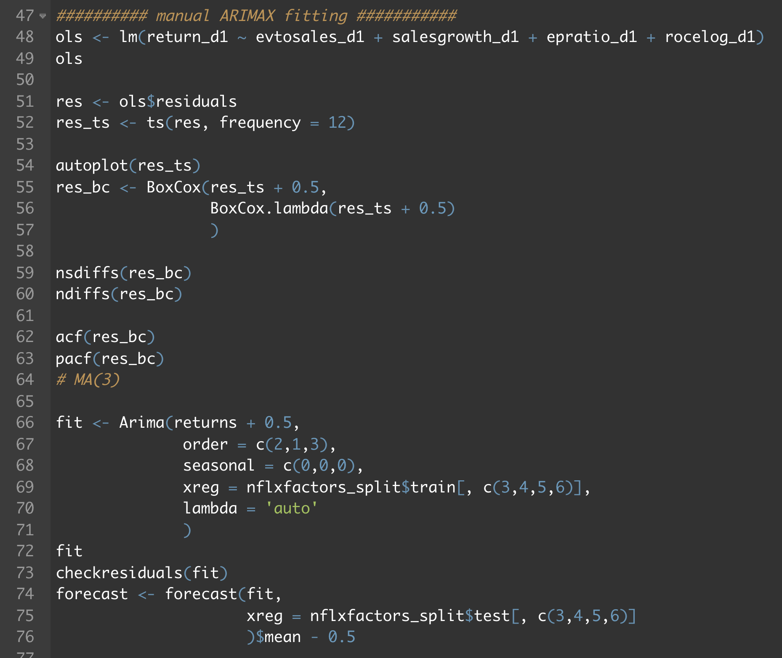
ARIMA-X Fitting
Add constant to ensure the input into Box-Cox transformation is positive
Arima() to handle OLS and ARIMA fitting all at once,
d = 1 for stationarity
lambda = 'auto' to let R perform Box-Cox for you (adding constant needed)
Subtract away the constant to
get meaningful forecast

Slide 25
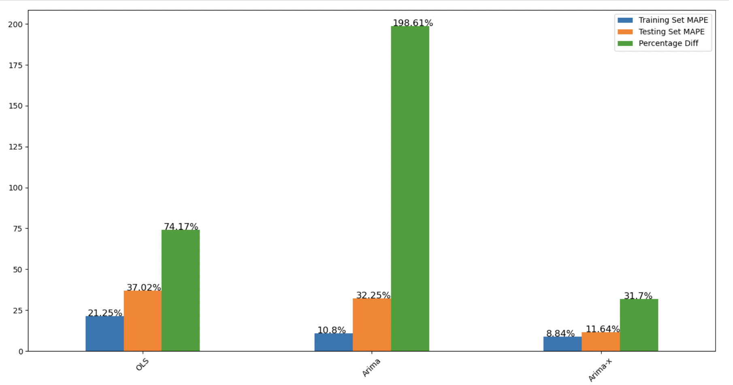
Model Comparisons - MAPE
Notes:
Beta from arima and arima-x not the most robust because only regress over one stock
Whereas OLS regress over 1000 hence more robust
Hence OLS has greater predictive power
And vecm should be considered
But no time

Slide 26

Phase 1: Trading Rules & P&L Tabulation
04

Slide 27

Building of Trading Positions and P&L Based on Fitted Values
Now that we have obtained the annual OLS-predicted returns over 10 years and monthly Arima & Arima-X predicted returns over 120 months, how then shall we make use of those figures to build our trading positions?
*Remember our project thesis – we are investing 25m in Netflix through 4 different strategies to see if it delivers superior combined performance vs just 100m into our fundamental model*
Notes:
Thank you team, now lets move on to building our trading positions from the fitted values obtained from our three quantitative models

Slide 28
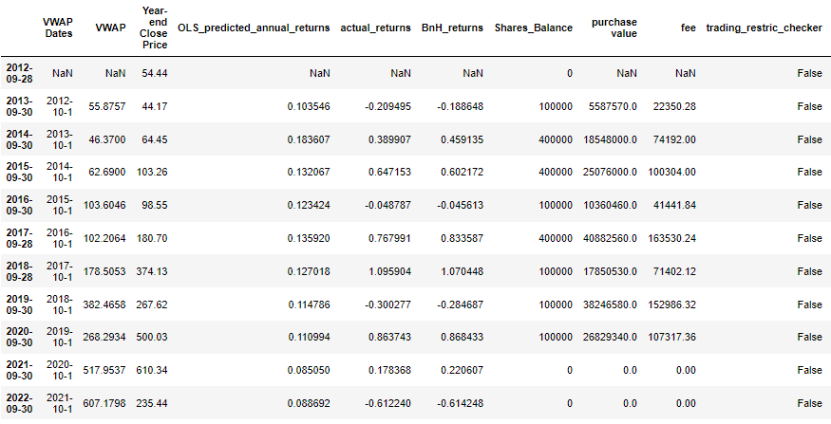
Building of Trading Positions and P&L Based on OLS-predicted Annual Returns
Trading Rules for OLS Model
1. 25m starting capital
2. Long-only strategy (3 tiers; annual rebalancing):
If at Sep financial year-end OLS model predicts > 13% annual returns for the subsequent financial year, long 400k Netflix shares on the next day at the day’s VWAP price and sell it off at year end
If at Sep financial year end OLS model predicts between 10% to 13% returns, long 100k shares the next day at the day’s VWAP price and sell it off at year end
If at Sep financial year end OLS model predicts less than 10% returns, neither long nor short
3. Added Restrictions on Purchase Notional:
All entry positions must not exceed 20% of Netflix's Average Daily Traded Value (ADTV) to not move Netflix’s market stock price
All purchase notional of the stock must not exceed 70% of outstanding net cash balance at time of purchase
4. Added Commissions:
0.4% of trade notional as trading fees/commissions
5. Specified Minimum Hurdle Rate our investment IRR cannot fall under:
CAGR % of our returns over the investment horizon must be above 10% which is the historical S&P 500 market average annualised returns (well we want to beat the market)
Full Table in Python Appendix
Notes:
First and forecast comes the trading rules for our OLS model. Starting capital of 25m. It is a long-only strategy that involves annual rebalancing and so at every September financial year end, we use our OLS model to forecast a year forward stock return and if its above a certain positive threshold, we long a certain number of shares the next day at the VWAP price and sell it off on the last day of the financial year. Our positive threshold comes in 3 tiers as shown in the slides. Also, all initial purchase trade notional must not exceed 20% of netflix’s average daily traded value in order to not move netflix’s stock price. We set trading fees/commissions to be 0.40% of trade notional and all purchase trade notional must not exceed 70% of the outstanding net cash balance at the time of purchase. Shown on the right is a snippet of our P&L table build in python of which the full table in the appendix section.
We also added restrictions on purchase notional to not move market prices, added commissions and added minimum a hurdle rate that our investment IRR cannot under

Slide 29
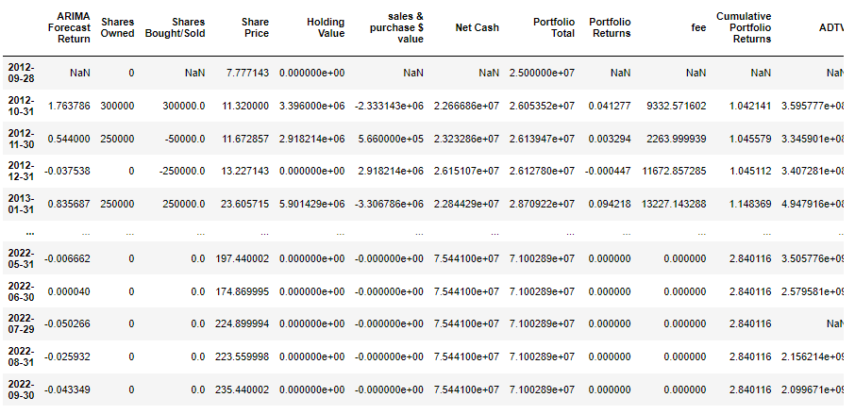
Building of Trading Positions and P&L Based on Arima-predicted Annual Returns
Trading Rules for Arima Model
1. 25m starting capital
2. Long-only strategy (4 tiers; monthly rebalancing):
If at month-end Arima model predicts > 100% monthly return for the subsequent month, OWN 300k Netflix shares for the subsequent month. So on the first day of the month, add more shares if currently do not have enough or trim if too much
If at month-end Arima model predicts between 50-100% monthly return for the subsequent month, OWN 250k Netflix shares for the subsequent month. So on the first day of the month, add more shares if currently do not have enough or trim if too much
If at month-end Arima model predicts between 10%-50% monthly return for the subsequent month, OWN 100k Netflix shares for the subsequent month. So on the first day of the month, add more shares if currently do not have enough or trim if too much
If at month-end Arima model predicts between 1-10% monthly return for the subsequent month, OWN 80k Netflix shares for the subsequent month. So on the first day of the month, add more shares if currently do not have enough or trim if too much
3. Added Restrictions on Purchase Notional:
All entry positions must not exceed 20% of Netflix's Average Daily Traded Value (ADTV) to not move Netflix’s market stock price
All purchase notional of the stock must not exceed 70% of outstanding net cash balance at time of purchase
4. Added Commissions:
0.4% of trade notional as trading fees/commissions
5. Specified Minimum Hurdle Rate our investment IRR cannot fall under:
CAGR % of our returns over the investment horizon must be above 10% which is the historical S&P 500 market average annualised returns (well we want to beat the market)
Full Table in Python Appendix
Notes:
Next up, for our arima strategy, the trading rules are very similar just that we rebalance our positions on a monthly basis and the same can be said for arima-x.

Slide 30
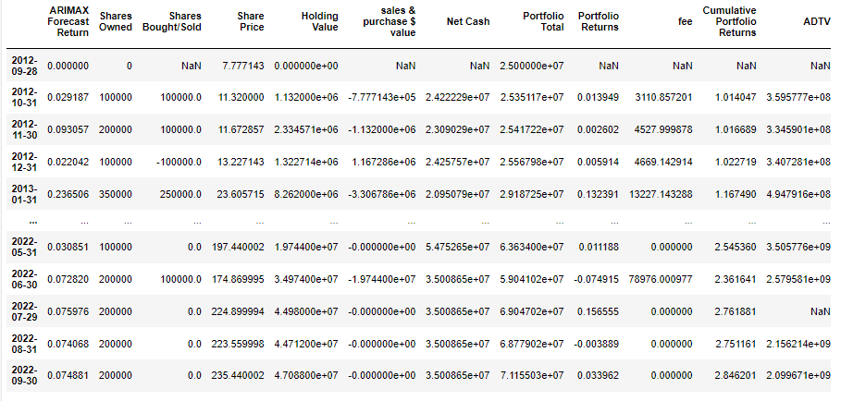
Building of Trading Positions and P&L Based on Arima-predicted Annual Returns
Trading Rules for Arima-X Model
1. 25m starting capital
2. Long-only strategy (4 tiers; monthly rebalancing):
If at month-end Arima-X model predicts > 20% monthly return for the subsequent month, OWN 350k Netflix shares for the subsequent month. So on the first day of the month, add more shares if currently do not have enough or trim if too much
If at month-end Arima-X model predicts between 10-20% monthly return for the subsequent month, OWN 300k Netflix shares for the subsequent month. So on the first day of the month, add more shares if currently do not have enough or trim if too much
If at month-end Arima-X model predicts between 5%-10% monthly return for the subsequent month, OWN 200k Netflix shares for the subsequent month. So on the first day of the month, add more shares if currently do not have enough or trim if too much
If at month-end Arima-X model predicts between > 0% monthly return for the subsequent month, OWN 100k Netflix shares for the subsequent month. So on the first day of the month, add more shares if currently do not have enough or trim if too much
3. Added Restrictions on Purchase Notional:
All entry positions must not exceed 20% of Netflix's Average Daily Traded Value (ADTV) to not move Netflix’s market stock price
All purchase notional of the stock must not exceed 70% of outstanding net cash balance at time of purchase
4. Added Commissions:
0.4% of trade notional as trading fees/commissions
5. Specified Minimum Hurdle Rate our investment IRR cannot fall under:
CAGR % of our returns over the investment horizon must be above 10% which is the historical S&P 500 market average annualised returns (well we want to beat the market)
Full Table in Python Appendix

Slide 31
Phase 1: Results: Did our Overall Portfolio Sharpe Ratio Improve w the Addition of Quantitative Trading Strategies?
05
Notes:
Just read off the slides

Slide 32
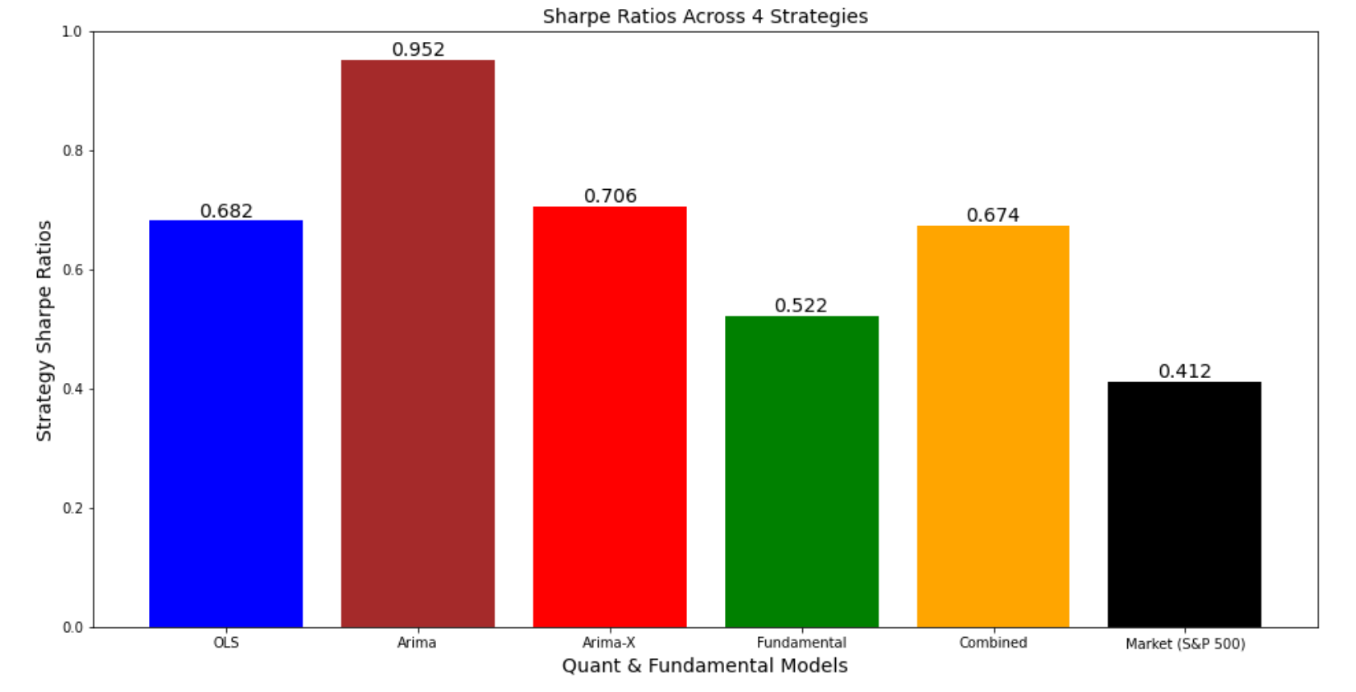
Sharpe Ratio Comparison Across the 4 Models & Equal Weight Portfolio
*Quantitative trading Strategies have INDEED enabled a traditional fundamental buy & hold equity analyst deliver superior risk-adjusted returns!
~0.70
Sharpe
Quant Wins!
~0.50
Sharpe
Combined Portfolio P&L Stream in Python in Appendix
Notes:
Next would be a visualization of the sharpe ratio across our 4 strategies and yes as it can be seen, quant wins! The sharpe ratio of our quantitative strategies are higher than the sharpe from investing in Netflix purely through our fundamental model which stands at 0.5 sharp and hence as it can be seen that naturally if you equal weight the 4 strategies and combine them naturally the overall sharpe ratio will be enhance which in this case specifically, it improved from 0.50 to 0.70. Mission accomplished!
So the results are shown in this chart and it can be seen as the standalone sharpe ratios of our 3 quantitative models are all higher than the sharpe ratio of our fundamental model which stands at about 0.50, the combined equally weighted portfolio which contains all 4 of these strategies delivers a superior sharpe ratio of about 0.70 vs the 0.5 sharpe we will get from just investing in Netflix through our fundamental model.

Slide 33
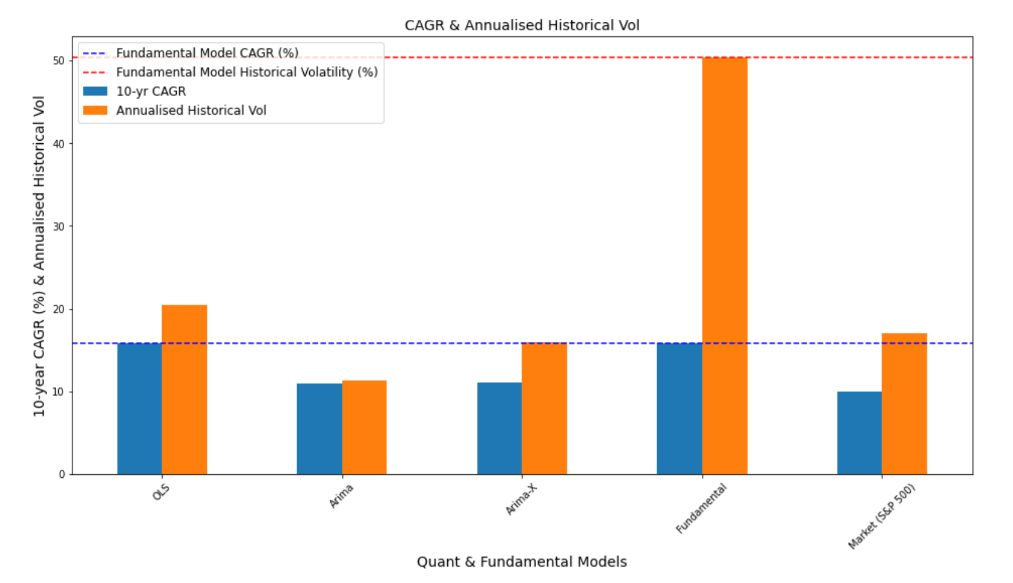
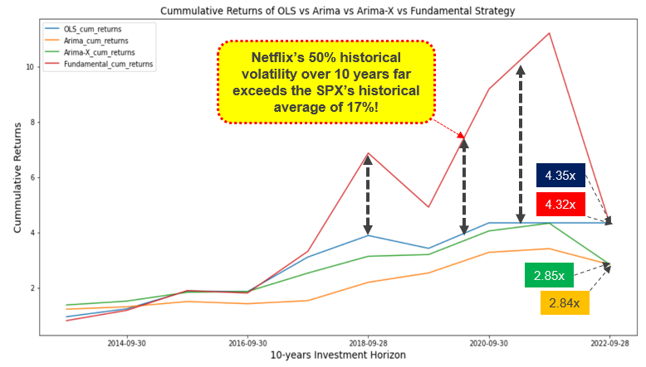
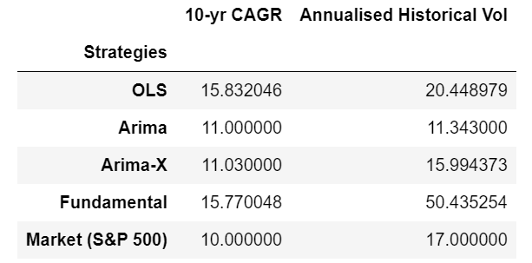
Breaking Down the Sharpe Ratio: High CAGR (IRR) or lower Historical Volatility from Quant Models
CAGR (IRR) % vs Historical Vol of 4 Strategies
Cumulative Returns (look at the volatility!)
~50% Vol
Neflix went through a hypergrowth phase the last 10-years as they burn cash to acquire more SVOD subscribers to gain market share, hence its stock price was very susceptible to drastic downs and ups from missing and outperforming concensus subscriber growth estimates
15.8% IRR
~14% IRR
~11% IRR
~11% IRR
Notes:
Next up, would be breaking down the sharpe ratio, was it the improvement of returns or the reduction in volatility that improved the overall sharpe ratio?
Returns justification: The combined internal rate of return from our 4 strategies actually stands at ~14% which is abit lower than the 15.8% IRR obtained from standalone fundamental model and this is due to the lower IRR from arima and arima x as shown in the diagram.
Vol justification: Where our quantitative trading strategy actually value adds is in the reduction of the overall volatility of our portfolio. Just investing in Netflix in a buy and hold strategy over the last 10 years will leave you exposed to a historical volatility of 50% which is very much higher than the average S&P 500 historical volatility of 17%. Now that’s because, Netflix was very much in the growth phase over the last 10 years where they rapidly burn cash to acquire more SVOD subscribers. The volatility of the 3 quantitative models ranges from 11 – 20% so you can see just by equal-weighting the 4 strategies we can reduce the overall portfolio volatility, hence leading to a higher combined equal weight portfolio sharpe as seen from the earlier slide

Slide 34
Phase 2: 1-year Forward Predicted Netflix Stock Price Comparison Across our Models (30th sep 2022)
06
Notes:
Next up will be phase two where we compare the predicted 1 year forward stock price starting from 30th sep 2022.

Slide 35
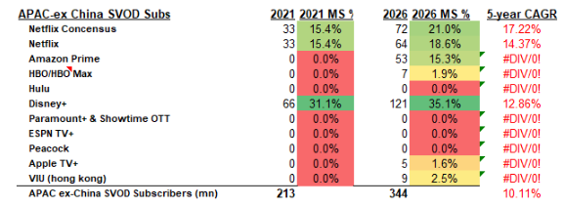
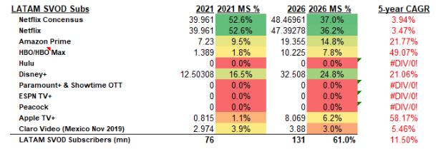
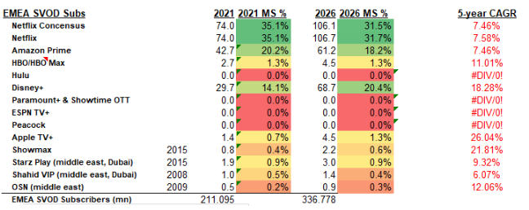
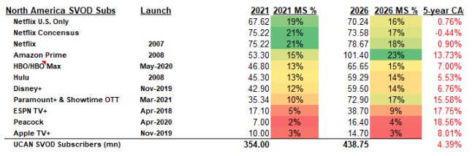
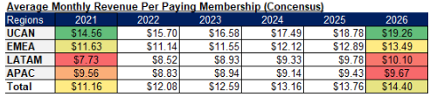
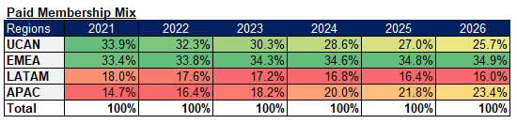
Fundamental Model Parameters and Construction
5-year fundamental buy-and-hold investment horizon
5-year average trailing PE is around 103x, SPX tends to trade at 15x P/E in base market so ~20x 5-year terminal P/E is fair
Considered factors like the pivot to the fast-growing AVOD sector from SVOD, headwinds from slowing subscriber growth propelled by the introduction of new incumbents like paramount+, Disney+, peacock and heating battle with incumbents like amazon prime, HBO, Hulu, etc., saturation in the north American region and tight competition in EMEA implies a 10.3% annualized earnings growth across 5 years which is not too far off consensus earnings estimate of 11%
A good entry price for 5-year annualized 15% CAGR stock returns would be 187 (1.5x PEG & 16x trailing 12M PE) today and the price at the end of the 5-year holding period is expected to be 376 and 1 year forward expected price is forward to be around $215.
Our current internal forecast implies that by 2026 paying subscribers penetration rate will be 63% in North America, 45% (now 45%) in LATAM 28% (26% now) in EMEA, 32% (now 19%) in Asia ex-China, global ex China 32% (from 29%)
Our current forecast implies that monthly ARPU for paying subscribers will be as shown on the bottom right of this slide
Notes:
To forecast the one year forward price for our fundamental analysis strategy, we build a 5 year DCF model and made certain assumptions on the monthly ARPU, SVOD penetration rates across Different regions in the world, market share and so on. In the interest of time, sadly, I will have to just touch and go on this.

Slide 36
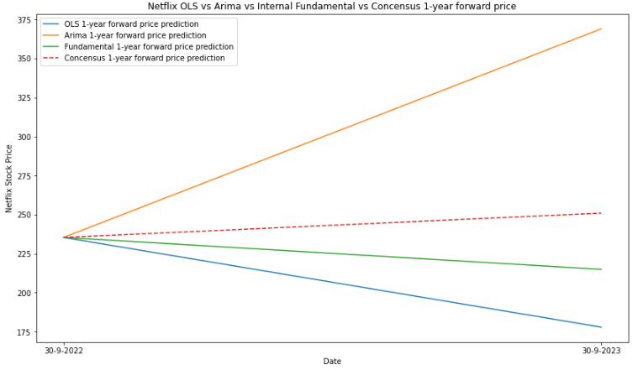
Finally, One-year Forward Netflix Stock Price Comparison for Fundamental vs Arima vs OLS vs Market Consensus
With a 1-year forward price of $215 as per our fundamental model in which we deem as the “right” price from a fundamental analysis standpoint, the Arima-predicted 1-year forward price has a larger deviation (72%) vs OLS at (17%), in line with the lower % difference in MAPE between testing and training set for OLS. This result is also in line with Arima’s inferiority when it comes to predicted prices beyond 1 month
369
~72%
251
235
215
~17%
178
Notes:
So finally, we have the various one year forward price for netflix predicted by our quantitative and fundamental models along with the wallstreet consensus stock price. We deem a year forward price of $215 forecasted by our fundamental model to be the “correct” stock price as it is backed by fundamental justification, such as market share, earnings growth rates ,etc., and it can be seen that the price predicted by Arima at 369 is 72% higher than the “correct” price and the price predicted by the OLS model at 178 is 17% lower vs the “correct” price. So as you can see from the graph the price predicted by the OLS is more accurate in this case. This ties in with our previous result that shows that our OLS model has greater predictive prowess compared to the arima model as it has a lower % difference between the testing set and training set MAPE. Also, as prof has repeatedly mentioned, the stock prices predicted by arima gets less accurate for any prediction longer than 1 month and hence the results as shown

Slide 37
THE END
Thank you for your kind attention, questions are open to the floor
Oh, and please do not take our price targets as investment advice, we will not be held accountable for your potential financial losses ☺

Slide 38
Appendix
07

Slide 39
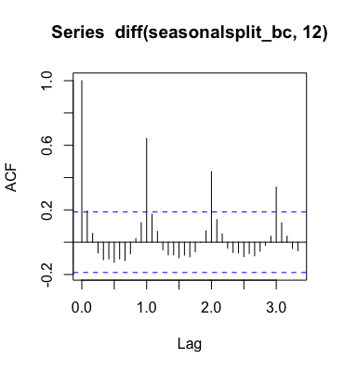
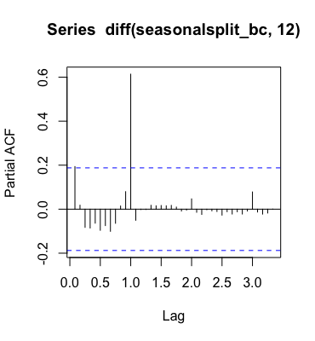
ARIMA order (seasonal) - ACF & PACF
- Exponential decaying pattern in ACF at seasonal lags -> SAR
- PACF suggests SAR(1)
- Exponential decay within each seasonal interval -> potential AR
Notes:
Notice diff(lag = 12)

Slide 40
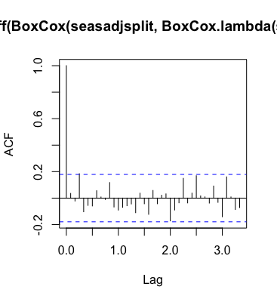
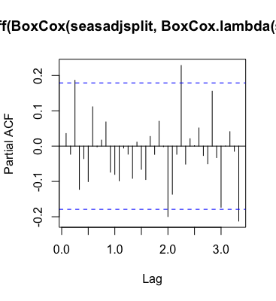
ARIMA order (seasadj) - ACF & PACF
- Possible exponential decay in PACF, more obvious at earlier lags -> MA?
- ACF suggests possibility for MA(3)
- Maybe an SMA component, but not clear enough
Notes:
Ndiffs() gives 1
Highlight that it is indeed possible to have seasonal pattern in seasadj
Seasonal patterns:
Maybe can consider SMA, not super obvious but can try

Slide 41
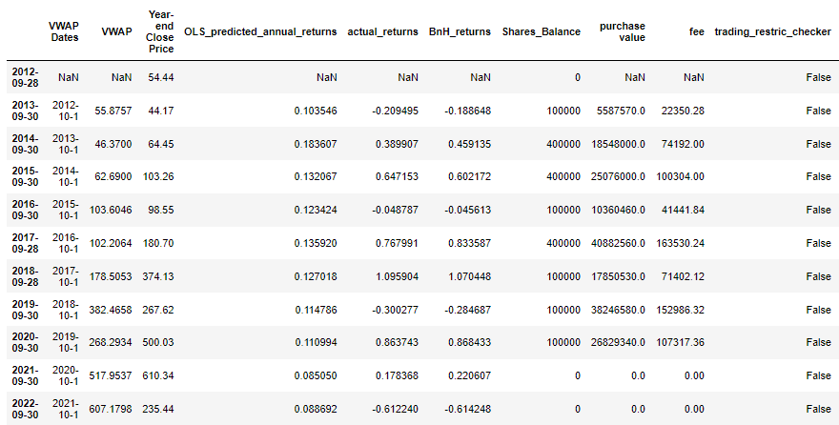
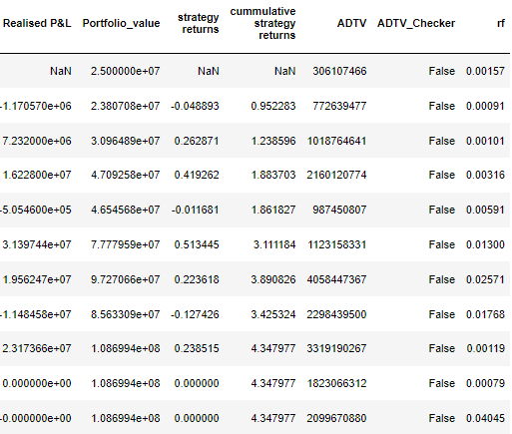
Table generated in Python for OLS strategy P&L tabulation

Slide 42
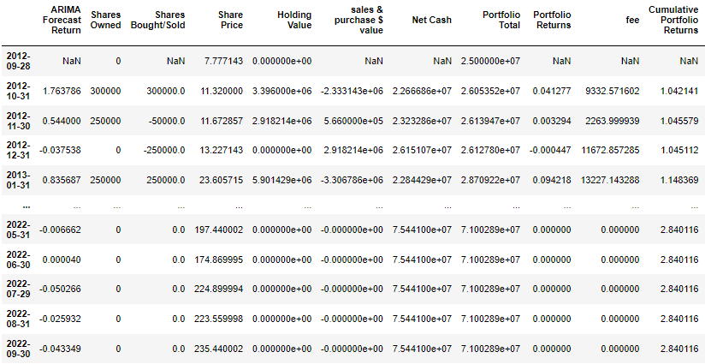
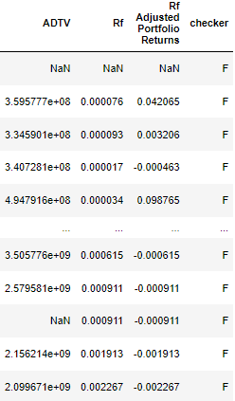
Table generated in Python for Arima strategy P&L tabulation

Slide 43
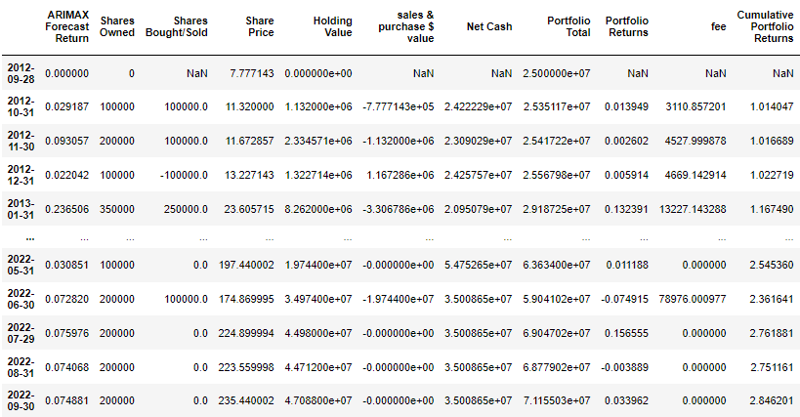
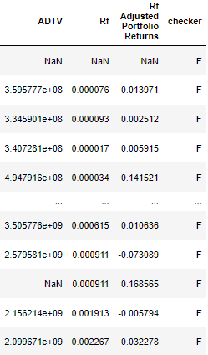
Table generated in Python for Arima-x strategy P&L tabulation

Slide 44
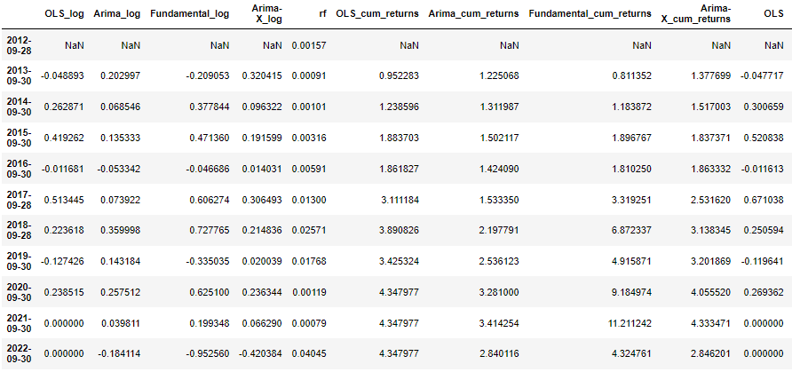
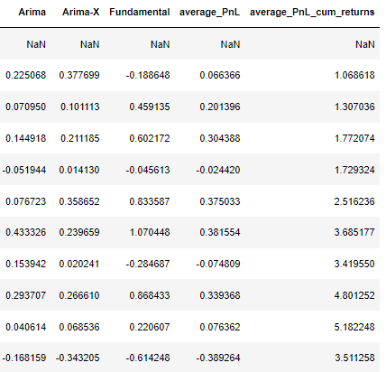
Combined Portfolio (OLS + Arima + Arima-X + Fundamental Model) P&L Table

Slide 45
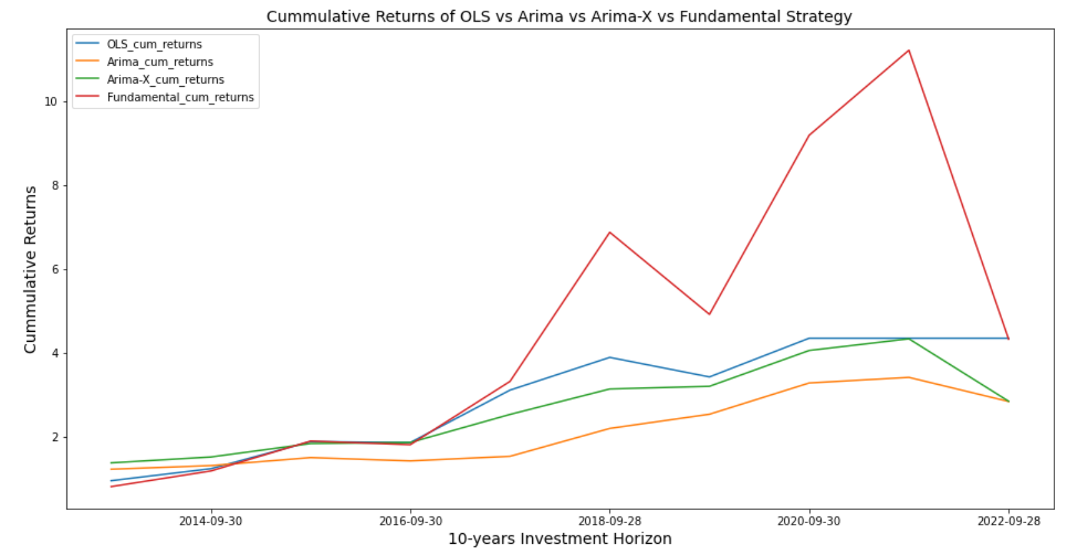
Visualization of Volatility of Cumulative Returns of all 4 Strategies
Our THREE quantitative trading strategies will certainly help to smoothen out Netflix’s historical volatility!
Netflix’s 50% historical volatility over 10 years far exceeds the SPX’s historical average of 17%!
4.35x
4.32x
2.85x
2.84x
Notes:
Referring to the graph, the red line represents the cumulative returns of investing in Netflix purely through the fundamental buy and hold strategy and you can see just how volatile the returns are vs the three quantitative trading strategies.

Slide 46
OLS Questions 1. Reasons for chosen Factors Cedric 2. Why Model 1 has t-stat more than 5 but no Standard Error Clustering Stephen (Model 1 Uses T stat higher than 5 that we need to perform standard error clustering. Only 1 Factor is higher than 5 in model 1, whereas there are 2 in Model 3) 3. What needs to be done if we fail White Test Stephen (White's heteroscedasticity-corrected standard errors) 4. Do we apply constants across all data sets Xiwen (Yes for that particular data element for consistency) 5. Can you explain more on robustness check permutations Xiwen 6. Is there Multicollinearity among your factors Stephen we use VIF to diagnose. VIF > 4 or tolerance < 0.25 may indicate, VIF > 10 or tolerance < 0.1 definitely has MC.

